Slide 1

Apprenticeships 2020
Or…..’One step beyond!’
Tony Allen
CEO
AAS Ltd

Slide 2
Apprenticeships 2020
?
Where are we?
What will 2020 look like?
Where have we come from?
How far do we have to go?
What will success look like?
Where are the Roadblocks?
Where do we go after 2020?

Slide 3



Where are we?
Apprenticeship Strategy & Rules
Employers committed
Levy
Frameworks out
Standards in (Trailblazers)
Institute for Apprenticeships
20% OJT / 10% SME

Slide 4


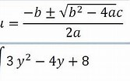
What will 2020 look like?
Political stability ?
Brexit done ?
No ESF or Apprenticeship allocations
HE Fees reform
No 3m target
Levy – complications / opportunities / changes
Focus on unspent / expiring funds

Slide 5

Where have we come from?
Since 2000:
Modern & Blueprint Apprenticeships
National Occupational Standards
NVQs & Frameworks
SASE / ACE / Higher and Degree Apprenticeships
Trailblazers / Standards
Qualifications In, then Out
Basic Skills / Key Skills / Functional Skills / GCSEs A to E and 9 to 1
D32 / A1 / PETLLS / IQA / EQA / FE Practitioner Standards
ETP / Train to Gain / AEB / 16-18 / Levy / Non-Levy
TECs / LSC / SFA / ESFA / NAS / LEPs / DIUS / DFE / DFEE / BIS
National Funding formula / Devolution / Levy / DAS etc etc

Slide 6

How far do we have to go?
Apprenticeships embraced by all – 20% Off Job
Be honest about the real cost
Trailblazer process
Devolved Nations clarity
End Point Assessment
All employers on Digital Account
Use of Levy – 10% transfer / wage enhancements
OFSTED - more vocational acceptance
Apprentice minimum wage £3.70ph
Two–year rule

Slide 7

What will success look like?
3 million!
Levy pot not overspent!
Parity of esteem – academic and vocational pathways
End youth unemployment
World class skill base
Greater economic prosperity
Closed productivity gap

Slide 8







Where are the Roadblocks?
The Real Cost of apprenticeships – an honest conversation
Employment Costs
20% Off job training – loss of productivity
Workplace support and mentoring
Risks to customer service / product quality
Induction / low productivity
Travel and Subsistence
Opportunity cost of additional training
The Levy / cost of training

Slide 9
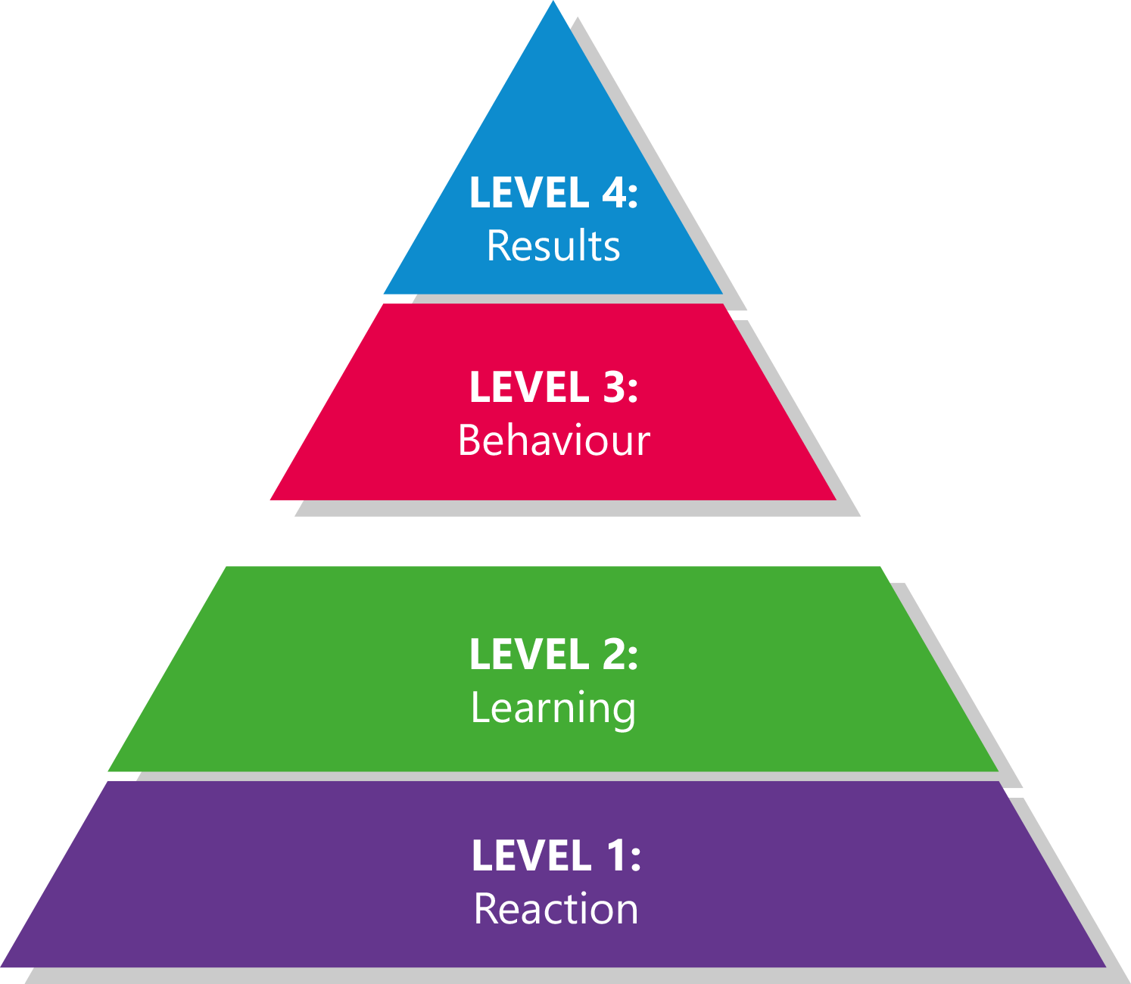
Where are the Roadblocks?
The Kirkpatrick
Model
Are we really getting what we want from apprenticeships?
eg
Skills and Competence
Career progression
Staff retention / motivation
Corporate Social responsibility
Effectiveness in role
Return on Training Investment
Targeted outcomes
Application in the workplace
Intended knowledge acquired
Engaged / Positive reaction

Slide 10
Where are the Roadblocks?
Effectively preparing students for work ?
Employer / FE perception
93% of colleges believe that they prepare students effectively for work
18% of employers
agree
Employer / HE perception
96% of universities believe that they prepare students effectively for work
11% of employers
agree

Slide 11

Where can we accelerate?
FE / HE Vocational Convergence
Degree Apprenticeships are the tool that will help….
Bring Employers / FE / HE together
Creating and measuring RoTI
Outcome focussed
Raising our standards
Integrated education.
From GCSE to MSc

Slide 12

Where to after 2020?
Rise of Degree Apprenticeships – HE acceptance
Stability in FE ‘market’
Real Impact measurement
Greater Employer discernment
Levy
  Skills not just Apprenticeships
  0.5% and £3m threshold?

Slide 13
Apprenticeships 2020
Or…..’One step beyond!’
Tony Allen
CEO
AAS Ltd

